Slide 1



Power BI Project
on
IMDB MOVIE DATA ANALYSIS
Presented By- Nilkanth Adhav

Slide 2

INDEX
Objective
Business Approach
Model View
Key Visuals
Link to Dashboard
Conclusion

Slide 3

Introduction
IMDb, the Internet Movie Database, is the world's largest and most reliable source for movie, TV, and celebrity content. Founded in 1990 and now owned by Amazon, IMDb serves over 250 million monthly visitors worldwide. The platform features detailed information on more than 12 million titles and 14 million cast and crew members, along with user ratings, reviews, and industry insights. For our analysis today, IMDb's extensive database provides valuable data points that help us understand audience preferences, industry trends, and content performance metrics.

Slide 4

Objective
Track movie trends: production, ratings, revenue, and genres over the past decade
Create an interactive dashboard for easy data exploration
Identify what makes movies successful
Provide insights for filmmakers and industry stakeholders to boost audience engagement

Slide 5
Approach
Dataset Used : IMDb Movie Data (12 columns and 1000 rows)
Steps Taken:
•Imported the dataset into Power BI.
•Removed missing, duplicated, and inconsistent records
•Split Genre column
•Build relationship in model view
Created DAX measures:
Total Movies
Total Votes
Total Revenue
Average Rating
Average Metascore

Slide 6
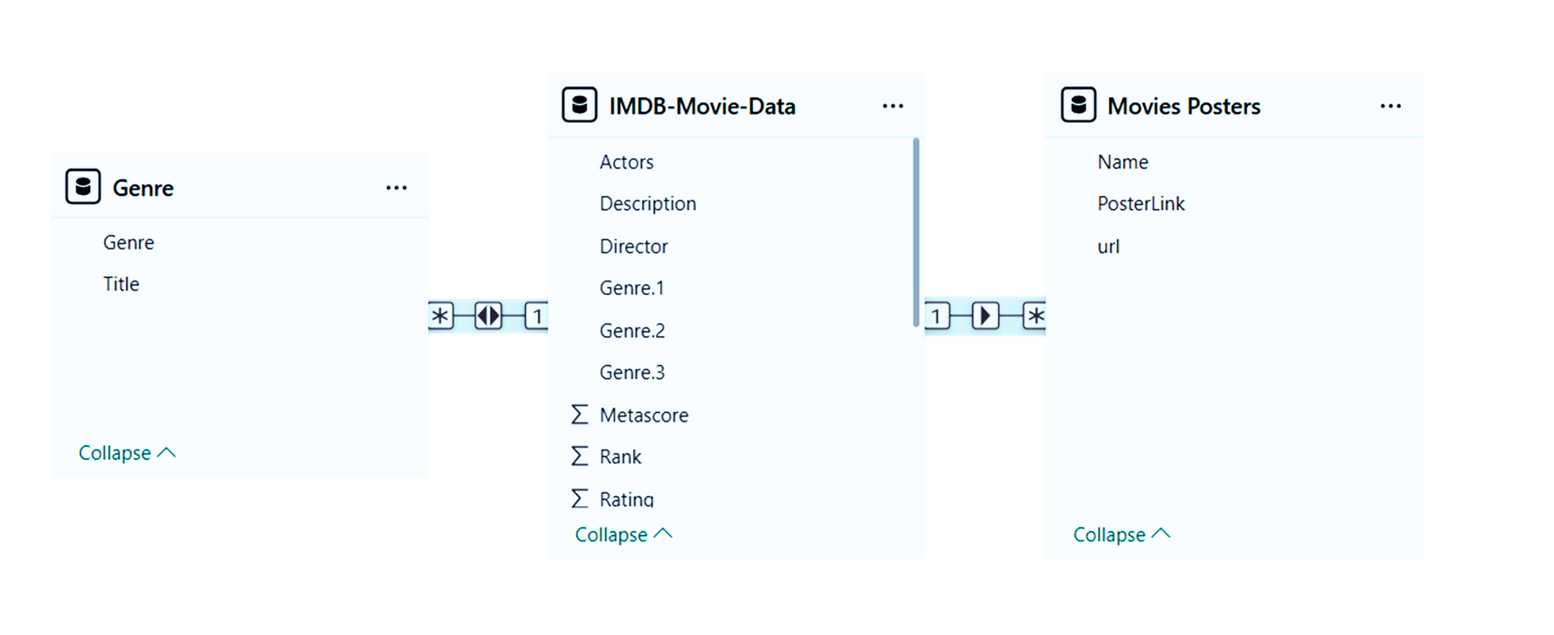
Model View

Slide 7




Key Visuals
Donat Chart: Shows average ratings for different movie genres
Funnel chart: Displays the number of movies released each year from 2006 to 2016
Stacked Column chart: Displays Yearly box office revenue in millions
Line chart:Analyzes relationship between movie runtime and revenue for top-grossing films

Slide 8
Dashborad

Slide 9
Conclusion
Movie production increased steadily from 2006–2016, while revenue increased over the decade. Western dominated average runtime, and genres like History, Musical, and Biography earned the highest ratings. Overall, the dashboard highlights clear trends in production, audience preferences, and genre performance across the decade.

Slide 10
Thank
you!

